Slide 1

Jessica Makar

Slide 2
Project Overview
This project explores customer purchasing behavior using a bike sales dataset containing demographic and lifestyle information for 1,000 customers. The goal is to identify patterns and trends that influence bike purchasing decisions by analyzing factors such as income, age, commute distance, education, region, and marital status.
Using Microsoft Excel, I organized and analyzed the data through PivotTables, created visualizations, and developed an interactive dashboard with slicers. This project demonstrates how data analysis and visualization can transform raw data into meaningful insights that support better business decision-making.

Slide 3
Dataset Columns
Unique ID – A unique identifier assigned to each customer.
Marital Status – Indicates whether the customer is married or single.
Gender – Identifies the customer's gender.
Income – The customer's annual income.
Children – The number of children the customer has.
Education – The customer's highest level of education.
Occupation – The customer's occupation or professional category.
Homeowner – Indicates whether the customer owns a home.
Cars – The number of cars owned by the customer.
Commute Distance – The distance the customer travels to work.
Region – The geographic region where the customer lives.
Age – The customer's age in years.
Purchased Bike – Indicates whether the customer purchased a bike.

Slide 4
Data Exploration & Analysis
Create a new sheet and paste all the data to preserve the original format of the dataset.
Examine the dataset using the “Filter” option in the data tab.
Remove duplicated rows. 26 rows were removed, 1000 unique rows remain.
Changed “Marital Status” and “Gender” values.
  Marital Status: replaced “S” and” M” with “Single” and “Married”
  Gender: replaced “M” and “F” with “Male” and “Female”
Reduce decimal places in the “Income” column for legibility.
Create an “Age Brackets” column using an IF statement and auto-filling the rest of the rows.
  The values that were added are:
    Adolescent – Younger than 31
    Middle Age – 31–54
    Old – Older than 54

Slide 5
Pivot Tables

Slide 6
Pivot Table 1
Pivot Table 2
Average of Income | Purchased Bike
Gender | No | Yes | Grand Total
Female | $53,440 | $55,774 | $54,581
Male | $56,208 | $60,124 | $58,063
Grand Total | $54,875 | $57,963 | $56,360
This pivot table compares the average income of male and female customers based on whether they purchased a bike. It helps identify income differences between bike purchasers and non-purchasers across genders.
Count of Purchased Bike | Purchased Bike
Age Brackets | No | Yes | Grand Total
Adolescent | 71 | 39 | 110
Middle Age | 318 | 383 | 701
Old | 130 | 59 | 189
Grand Total | 519 | 481 | 1000
This pivot table displays the number of customers who purchased and did not purchase a bike across three age brackets: Adolescent, Middle Age, and Old. It helps identify which age groups are more likely to purchase bikes.

Slide 7
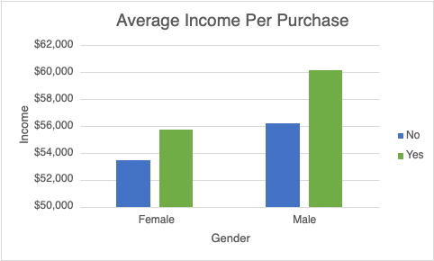
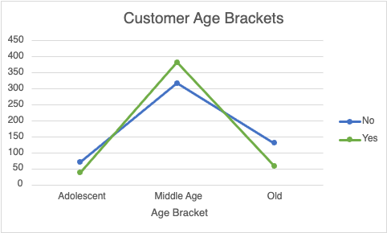
Pivot Table 1 & 2 Visualizations
This chart highlights that customers who purchased bikes had higher average incomes, with male purchasers earning the most on average.
This chart shows that middle-aged customers account for the highest number of purchases, while adolescents and older customers show lower purchasing activity.

Slide 8
Pivot Table 3
Count of Purchased Bike | Purchased Bike
Commute Distance | No | Yes | Grand Total
0-1 Miles | 166 | 200 | 366
1-2 Miles | 92 | 77 | 169
2-5 Miles | 67 | 95 | 162
5-10 Miles | 116 | 76 | 192
More than 10 Miles | 78 | 33 | 111
Grand Total | 519 | 481 | 1000
This pivot table compares the number of customers who purchased and did not purchase a bike across different commute distance categories. It helps identify how commute distance relates to customer bike purchasing behavior.

Slide 9
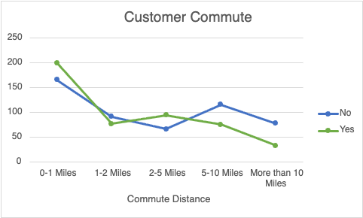
Pivot Table 3 Visualization
Customers with a commute distance of 0–1 miles had the highest number of bike purchases (200). Bike purchases generally decreased as commute distance increased, with customers commuting more than 10 miles having the fewest purchases (33).

Slide 10
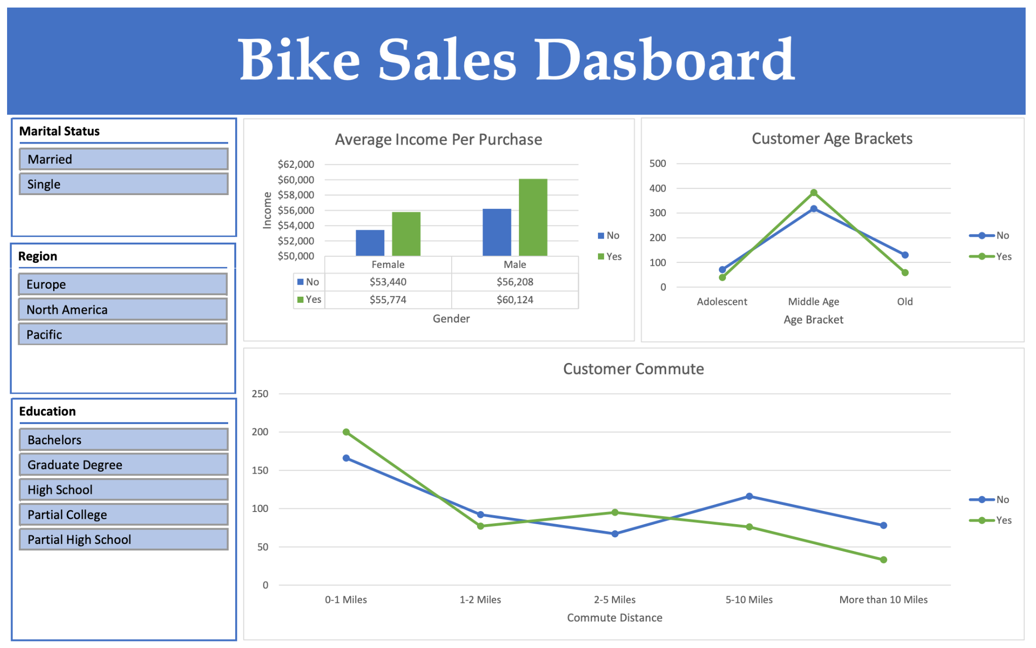
Dashboard Overview

Slide 11
Dashboard Description
The Bike Sales Dashboard provides an interactive overview of customer purchasing behavior and the factors influencing bike purchases. It includes three visualizations analyzing average income by gender, bike purchases across age brackets, and purchasing patterns based on commute distance. The dashboard features interactive slicers for education, region, and marital status, allowing users to filter the data and explore customer trends across different demographic groups.
Note: The full Excel workbook is linked at the top of the first slide.

Slide 12
Key Findings & Conclusion
The analysis revealed several patterns in customer bike purchasing behavior:
Income: Customers who purchased bikes had a higher average income than non-purchasers.
Age: Middle-aged customers had the highest bike purchase rate at 54.6%.
Commute Distance: Customers commuting 0–1 miles had the highest purchase rate, while those commuting more than 10 miles had the lowest.
Interactive Analysis: The dashboard allows users to explore customer purchasing patterns by education, region, and marital status.
This project demonstrates how Microsoft Excel can be used to organize raw data, identify customer trends, and transform information into an interactive dashboard that supports business decision-making.

